Slide 1
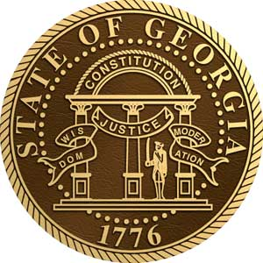
2018/19 Annual Report
GEORGIA CIVIL WAR COMMISSION|
JUNE 2018-JULY 2019

Slide 2
Letter from the Chairman
The Commission continued the expansion of our educational outreach efforts through attendance at expos where we spoke with attendees about the Commission, our heritage preservation efforts, and how we partner with parents, educators, and the larger community.
We will continue to work with the Governor, Lieutenant Governor, and Speaker of the House to fill the vacancies on the Commission. We anticipate a fully-staffed Commission as the Georgia General Assembly and State leadership identifies future Commissioners.
Our voice and impact is not impeded by our numbers. We have maintained a presence at the Capitol during the legislative sessions and locally at municipal and county meetings.
The Georgia Civil War Commission has strengthened and built relationships with affiliate heritage preservation organizations, groups, and researchers.
We are grateful for the resources provided by the Georgia taxpayers and are excited about the progress we have made toward our mission as outlined by the Georgia General Assembly.
We invite you to explore our progress over the past year and to learn more about us, visit www.georgiacivilwar.org.
Sincerely,
John Culpepper, Chairman
Kelly Barrow, Vice Chairman

Slide 3
Highlights
Field Trip Fund monies available to educators
Annual art & essay contests
Commissioner appointment & vacancies
Presence at the Capitol during the legislative session
Johnston River Line Park renaming in Cobb County
Battle of Atlanta

Slide 4
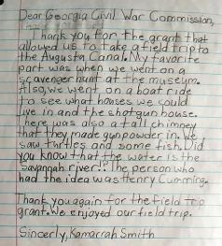
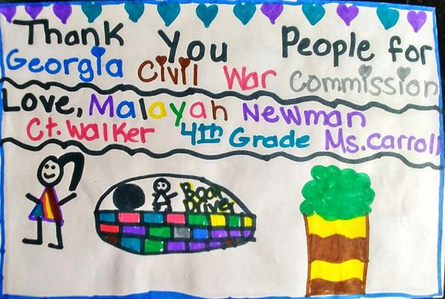
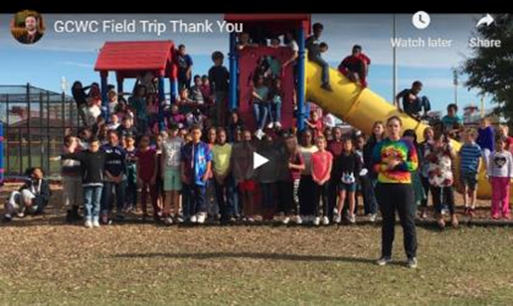
Field Trip Fund: CT Walker Traditional Magnet School (Augusta)
The Commission offers up to $250 per K-12 class, school club, and home school funds to assist with field trips to visit Georgia Civil War monuments and sites. A total of $1,000 is set aside.
CT Walker Traditional Magnet School in Richmond County is the first recipient of these funds.
Over 100 CT Walker School students enjoyed a trip to the Augusta Canal where they learned about Augusta’s role in the Civil War.
This is the first field trip for some of the students. The field trip helped solidify their in-class teaching.
The class submitted “thank you” notes and a video in response to the gift.
Thank you to Ms. Carroll for allowing us to support your educational efforts.

Slide 5
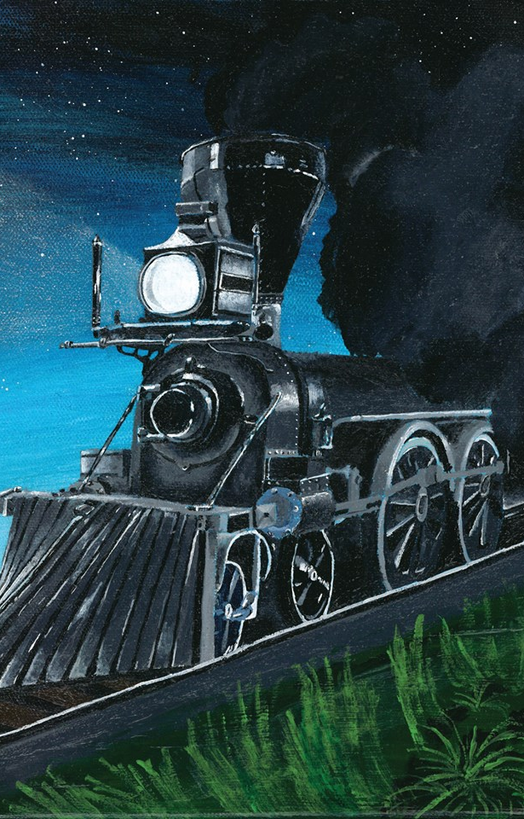
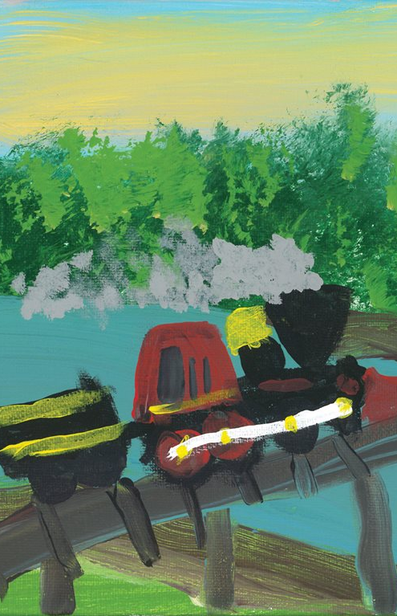
Art Contest
Topic: Georgia’s Locomotive Chase
Grades: K-12
Categories: K-2nd, 3-5th, 6-8th, 9-12th
Prizes:
$200, $150, $100 prizes in each category
Certificate & Georgia State House Resolution
On display at Kennesaw State University’s Collectors Showcase & Symposium
Featured in the Commission’s 2019 calendar and distributed to Civil War historians, enthusiasts, expo attendees, and the Georgia General Assembly.
D. Armstrong secured first place in the 9th-12th grade category.
C. Rickerson placed 1st in the Kindergarten to 2nd grade category

Slide 6
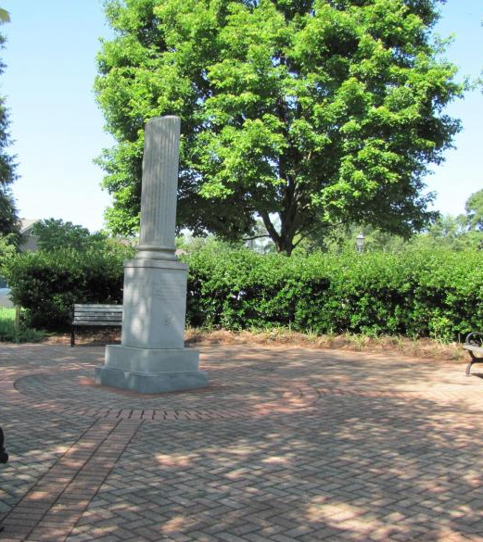
Essay Contest
Topic: What happened to the Women of Roswell and/or New Manchester Mill’s workers during the Civil War
Winners:
5-6th grade
1st place: Nadia Cerdas
2nd place: Andrew Fleming, Shelby Gwinn, Naomi Thompson
7-8th grade:
1st place: Samuel Klemm
9-12th grade:
1st place: Ashley Klemm
2nd place: David Osborne
3rd place: David King
Prizes:
$250, $200, $150 in each category
Certificate & Georgia State House resolution
Essays are printed in a booklet & distributed at the Collectors Showcase at Kennesaw State University and throughout the state

Slide 7
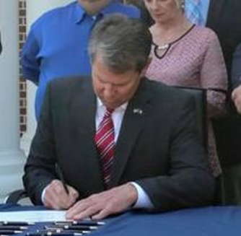
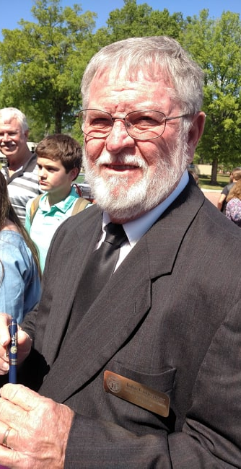
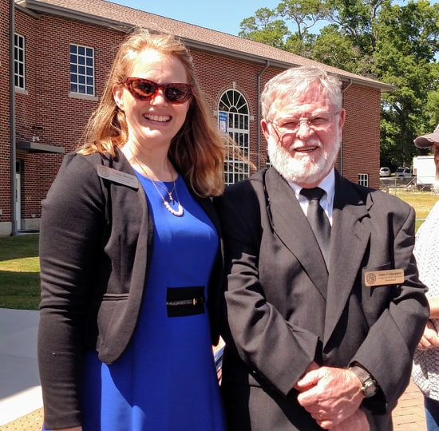
Presence at the Capitol
Chief of Staff Cassie Barrow educated legislators and supported bills to protect military monuments in Georgia. SB77 was signed into law on April 26, 2019 and became effective July 1.
Each legislator received a copy of our annual report and quarterly newsletter.

Slide 8
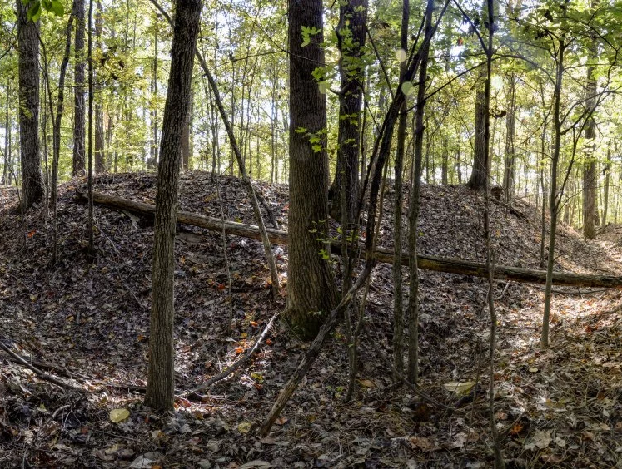
Renaming Johnston’s River Line Park
Located on Discovery Blvd. in Cobb County on over 100 acres
Named in honor of Confederate General Johnston
Contains a variety of well-preserved and unique Civil War earthenworks known as shoupades
Cobb County has the only shoupades in the world
Listed on the National Register of Historic Places
Some Cobb County residents want the Park renamed to Mableton Discovery Park
The Commission crafted a resolution and presented it to the Board of Commissioners keep the name of the park as Johnston’s River Line Park. The video is available on the Commission’s Facebook page at: https://www.facebook.com/120462404685199/videos/1800853663312723/
There has been no final resolution.
Photo by Clint Brownlee

Slide 9
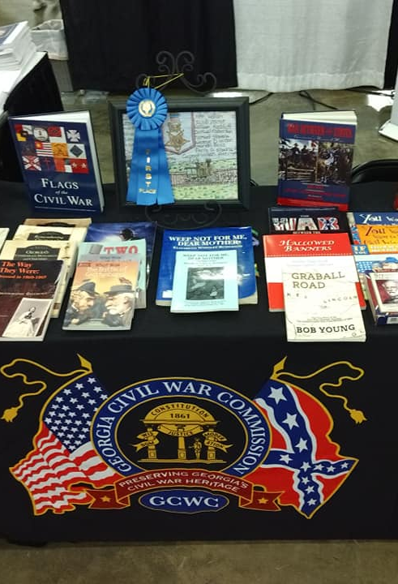
Educational outreach
We spoke to thousands about the Commission’s offerings and how we support their educational efforts at the:
Southeast Home School Expo
Georgia Council for the Social Studies
EPIC (Experience, Participate, Inspire, Connect) Home School Network Expo
Donated Charged with Treason: Ordeal of 400 mill workers during military operations in Roswell, Georgia 1864-1865 by Michael Hitt to local libraries to fill a resource gap & in honor of essay contest winners
Purchased the remaining copies of the Crossroads of Conflict books to donate and use as giveaways

Slide 10
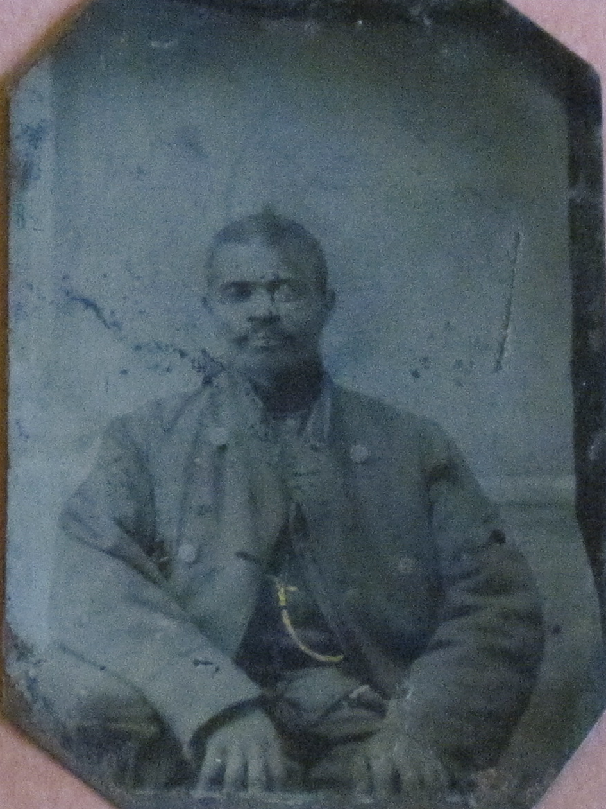
Relationships & Research
We engaged and enhanced relationships with heritage preservation groups and supported research to uncover mysteries about those who lived during the Civil War era.
Key sponsors of the 17th Annual Symposium and the Collectors Showcase at Kennesaw State University
Greetings to the Ladies of the Grand Army of the Republic & the Daughters of the Union Veterans National Convention
Letters to support the preservation of Camp Letterman General Hospital in Gettysburg
Funding for Brad Quinlan’s research to document all men of African descent that served in Sherman’s army in the Summer/Fall of 1864 & Winter/Spring of 1865 to Include the men of the 136th and 138th United States Colored Troops
Battle of Atlanta Commemoration Organization (BATL) grant to restore & renovate the Walker and McPherson monuments
Hosea Simmons 45th Illinois Infantry Undercook

Slide 11
Budget vs. Expenses: 2018-2019
 | Budgeted | Expenses | Remaining
Meals/ Lodging/ Mileage | $2,000.00 | $1,839.32 | $160.18
Supplies/Bank Charges | $1,200.00 | $872.71 | $327.29
Website | $600.00 | $554.74 | $45.26
Education Expos | $5,500.00 | $5,458.56 | $41.44
Art & Essay Contests | $4,300.00 | $4,219.69 | $80.31
Field Trip Assistance | $250.00 | $250.00 | $0.00
Financial Assistance | $0.00 | $0.00 | $0.00
Commission Projects | $15,800.00 | $15,733.80 | $66.20
Education Fund FNFB | $4,079.00 | $0.00 | $4,079.00
Office Rent | $1,350.00 | $1,350.00 | $0.00
Total | $35,079.00 | $30,279.32 | $4,799.68**
** Reserve funds were used specifically to purchase the Crossroads of Conflict books which is a Commission publication

Slide 12
What’s ahead for 2019-2020
Website update (www.georgiacivilwar.org)
Art & Essay contests
Educational expos
Field trip funding assistance
Appointment of additional Commissioners
Relationship-building & research support

Slide 13
Structure
15 Commissioners
9 members (6 vacancies) from across Georgia
Appointed by:
Governor
Lt. Governor
Speaker of the House
Chief of Staff
Quarterly meetings
$25,000 annual budget appropriated from the Georgia General Assembly

Slide 14
Commissioners
Kelly Barrow, Vice Chair
Curt Collier
John Culpepper, Chair
Inger Eberhart, Treasurer
Ken Griffiths
Karen Ledford
Hank Segars
Brian Wills, Ph.D.
James Yancey, Secretary
Chief of Staff: Cassie Barrow

Slide 15
Annual Report
GEORGIA CIVIL WAR COMMISSION

